Slide 1
Good morning and welcome

Slide 2
Work Breakdown Structure
Recipe for customer satisfaction & efficiency

Slide 3
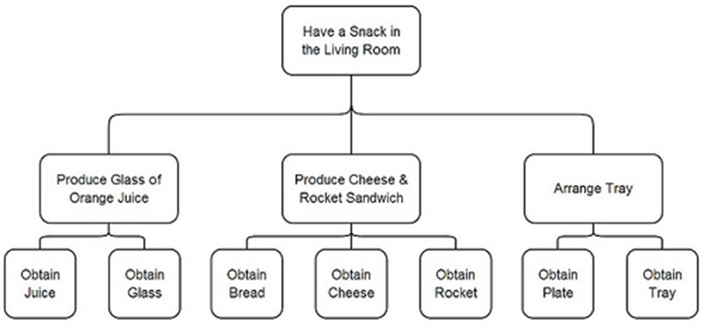
Work Breakdown Structure - Example
What do I need when I want to have a snack in the Living Room?
Project / Assignment
Components
Activities

Slide 4


Work Breakdown Structure - Example
Potential problems?
2
1
1
Orange juice is not freshly produced, but I want it fresh
2
Tray has not been arranged, and snack falls on the floor

Slide 5

Work Breakdown Structure - Example
How to avoid problems?
Check if customer has same understanding of components
Check preparation of each component with customer

Slide 6
What is a work breakdown structure ?
https://www.linkedin.com/learning/project-management-foundations/what-is-a-work-breakdown-structure?autoplay=true

Slide 7
Work Breakdown Structure – E-learning Application
E-learning Application
Kick-off Meeting
Story-board
Alpha Version
Beta Version
Gold version release

Slide 8
Kick-off Meeting
E-learning content
E-learning application functionalities
E-learning project plan
E-learning contract
Handshake with customer

Slide 9
Storyboard
Page examples (for all e-learning content)
Page number & type (Interactivity / Animation)
Voice-over
Notes to developers
Sign-off from customer

Slide 10
Voorbeeld Storyboard
https://www.storyboardthat.com/storyboards/orange45/work-breakdown-structure

Slide 11
Alpha version
First application version with all pages & pictures
Computer voice-over
Animation & Interactivity
Official feedback from customer

Slide 12
Beta version
Improved application version with all pages & pictures
Improved Computer voice-over
Improved Animation & Interactivity
Official feedback from customer

Slide 13
Gold version
Release application version with all pages & pictures
Professional voice-over
Final Animation & Interactivity
Official release from customer

Slide 14

The end

Slide 15
Questions please ?

